Slide 1
Shell Bootcamp 2024 3 Reflections for Week #<>
Anshul Sathe
Date : 30-Aug-2024

Slide 2

About Me
“There’s no job too immense when you got confidence.”
- Elvis Presley

Slide 3

My learnings from this week!

Slide 4
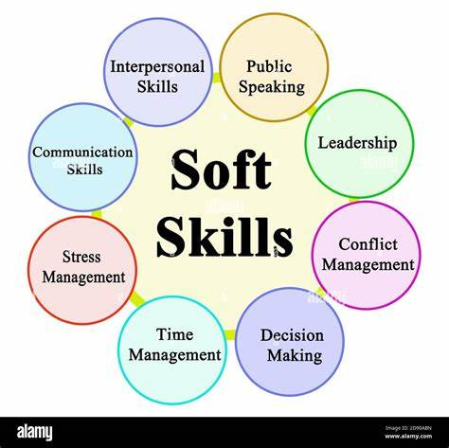
Learning 1 | My takeaways
Personality Traits
Etiquettes
Stakeholder Management
Trust
Problem Solving and teamwork
Effective Presentation techniques

Slide 5

Learning 2 | My takeaways
Importance of Business Analyst
Analysis Models
Corporate learning models
Comparisons between different models
Waterfall model
Scrum and Kanban

Slide 6
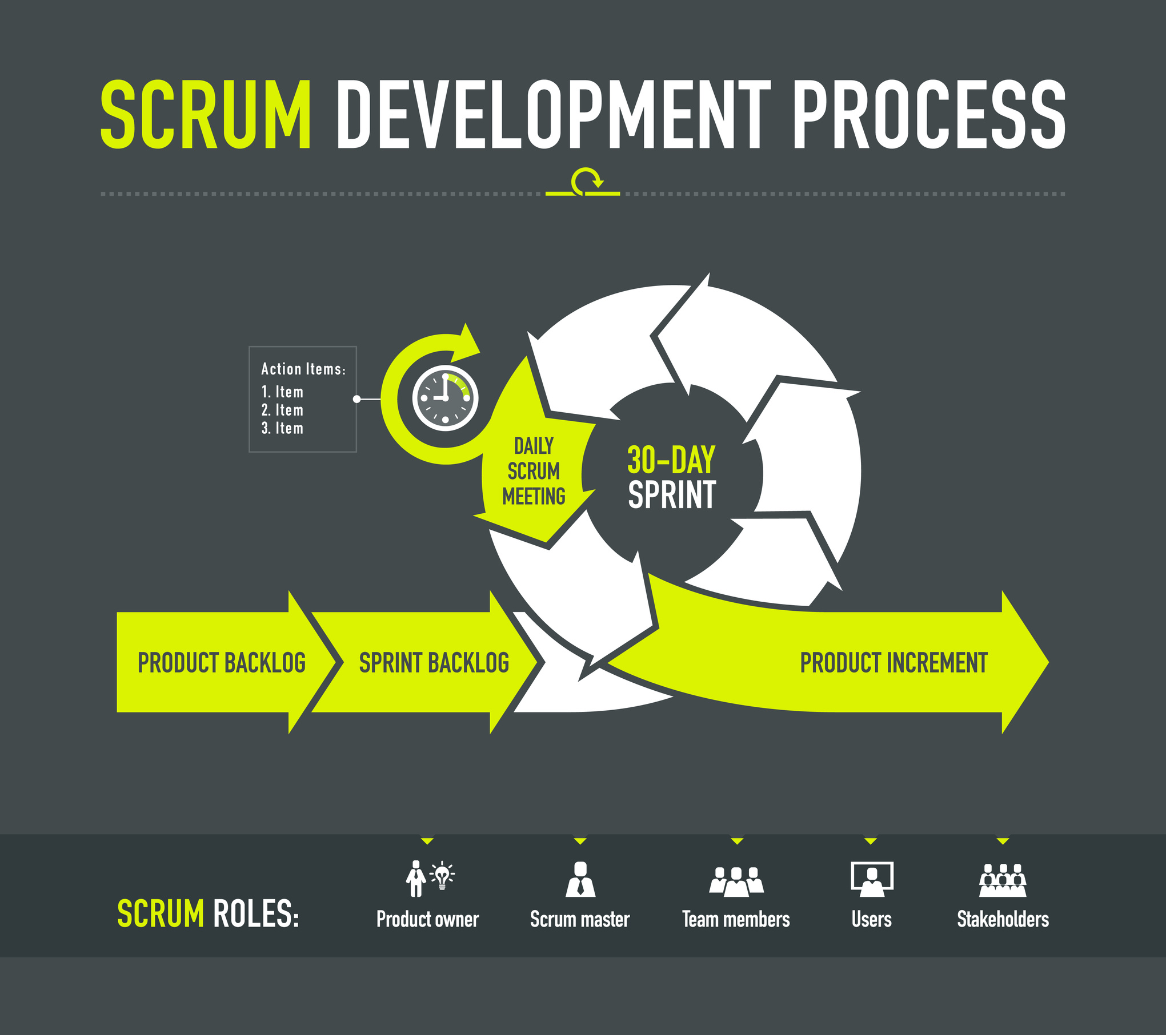
Learning 3 | My takeaways
Agile Principles
Scrum Model
Epic
Story
Task and subtask
Spike and enabler story
Sprints

Slide 7

Relevance of learnings for my organization

Slide 8

Learning 1 | Relevance for Shell
A good personality and strong ethics and proper etiquette foster a positive work environment, build trust and enhance teamwork. They demonstrate professionalism, reliability and respect, making you a valued and effective employee. These traits also contribute towards personal growth and career advancement.

Slide 9

Learning 2 | Relevance for Shell
A Business Analyst in the software field bridges the gap between stakeholders and developers. They ensure requirements are clear, feasible, and aligned with business goals, enhancing project efficiency and success. Their role is crucial for translating business needs into technical solutions, minimizing risks, and optimizing resource utilization.

Slide 10
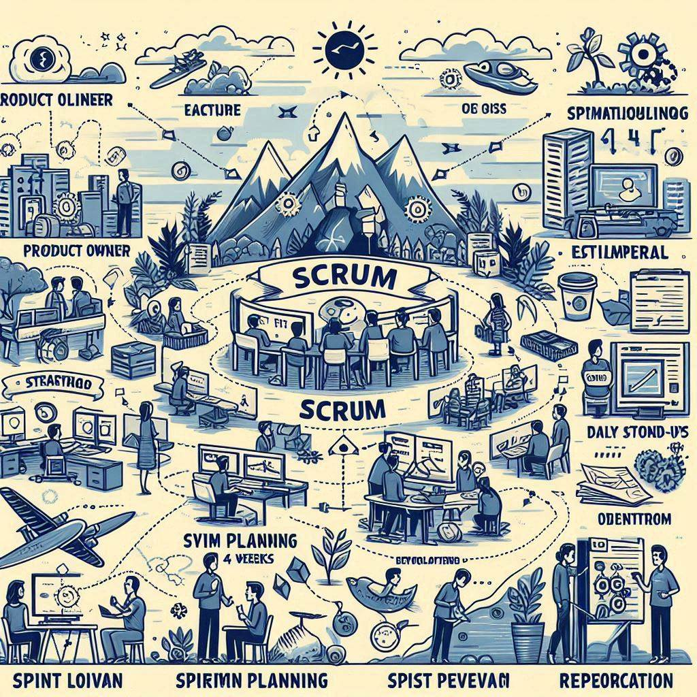
Learning 3 | Relevance for Shell
Scrum is an agile framework for managing complex projects. It involves iterative development, with work divided into sprints (typically 2-4 weeks). Key roles include the Product Owner, Scrum Master, and Development Team. Daily stand-ups, sprint planning, reviews, and retrospectives ensure continuous improvement and adaptability.

Slide 11

Challenges in implementing learning

Slide 12

Challenge faced while implementing Learning 1
No problem so far. Implemented importance of soft-skills, personality traits and etiquettes in role play during class.

Slide 13

Challenge faced while implementing Learning 2
No problem so far. Implemented mock play of business analyst in a project successfully.

Slide 14
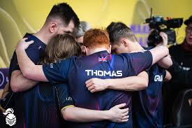
Challenge faced while implementing Learning 3
Sprints and scrum tasks implemented successfully.

Slide 15

Action Plan

Slide 16
My Action Plan for this Week
Actions
Timeline
Status
Implement these skill in practically in real life.
Working on personality and soft skills in the first 3 days of the week,
Study technicalities in the next 2 days
Goals achieved.

Slide 17

Learning is also Fun!

Slide 18

Learning is also Fun!
The use of different class activities made this a very interactive and fun learning experience in both technical and soft-skills sessions. I have learned a lot from what my facilitators have taught me, and I am very sure that I will be able to implement this in my practical workday and this will help me in my personal and professional career as well.

Slide 19

Summary
We learned the importance of personality development and practicing proper etiquettes.
Importance of team-work, good leadership qualities and collaboration was taught.
Importance of Business analyst was also emphasized.
The next week consists of Dev-Ops and Scrum practicality.

Slide 20
Thank You

